Slide 1
Verification of NOAA’s Kp and Ap Space Weather Forecasts
Henry Jordan
Advisor: Tom Berger (NCAR HAO)
Collaborators: Andong Hu, Prateek Mayank, Enrico Camporeale

Slide 2
Overview
Overview of Space Weather
Motivation: Chaotic vs. Strongly Driven Systems
Verification of SWPC Kp and Ap forecasts

Slide 3
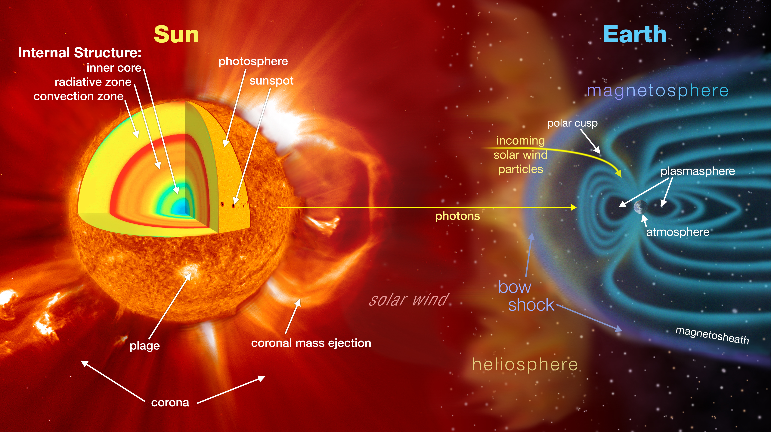
The Sun-Earth System

Slide 4
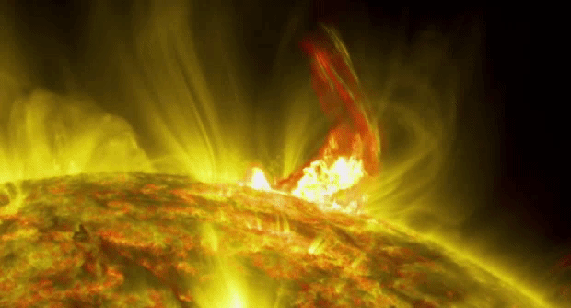
Coronal Mass Ejections
Magnetic reconnection expelling large amounts
Charged particles

Slide 5
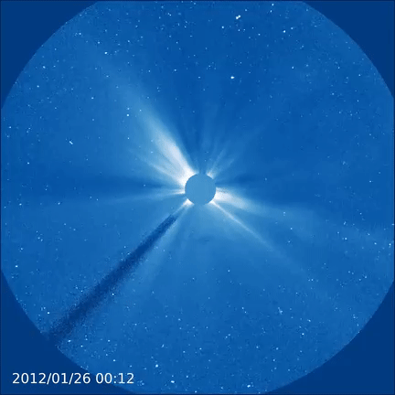
Coronal Mass Ejections
Magnetic reconnection expelling large amounts
Charged particles
Drive Large Geomagnetic Storms
Take ~14-48 hrs to travel to the Earth

Slide 6
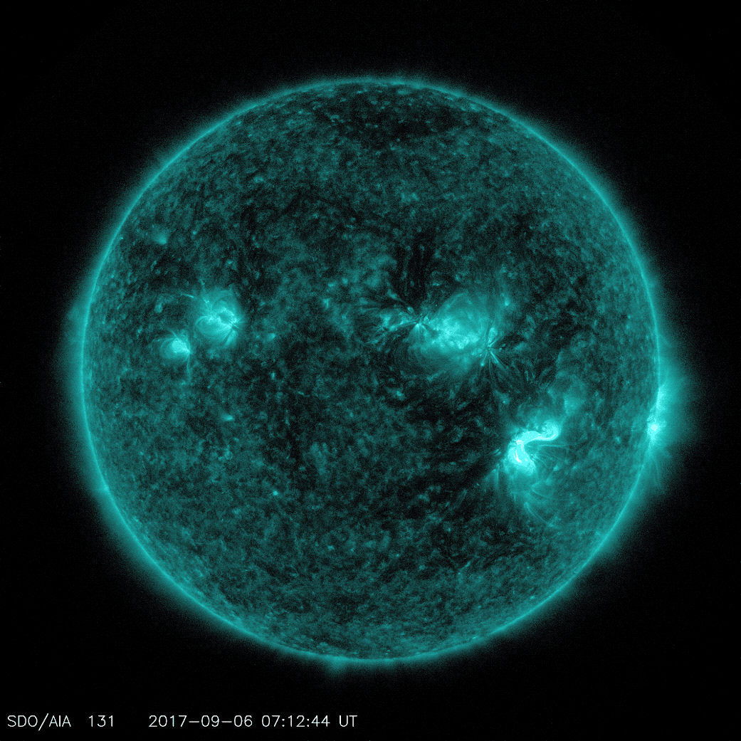
Solar Flares
Huge release of undirected EUV radiation
Often occur along with CMEs
Drive ionization of ionosphere
Which can cause radio blackouts

Slide 7
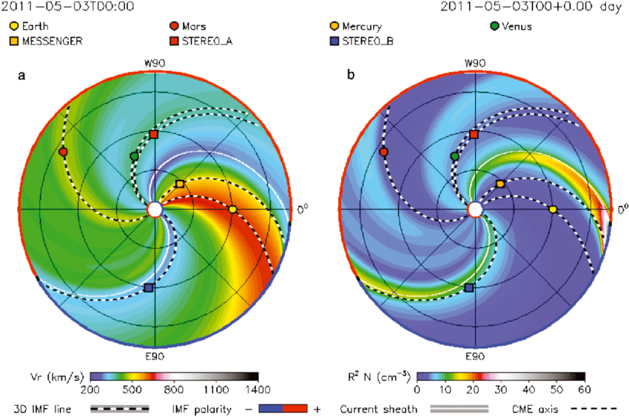
Ambient Solar Wind
Continuous stream of protons
Out of active regions
Generate less intense geomagnetic
disturbances

Slide 8
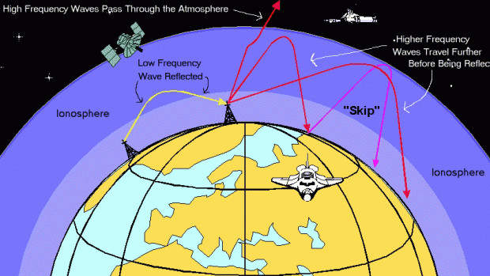
Space Weather Impacts
Short Wave Radio Blackouts
Communication and GPS failure

Slide 9
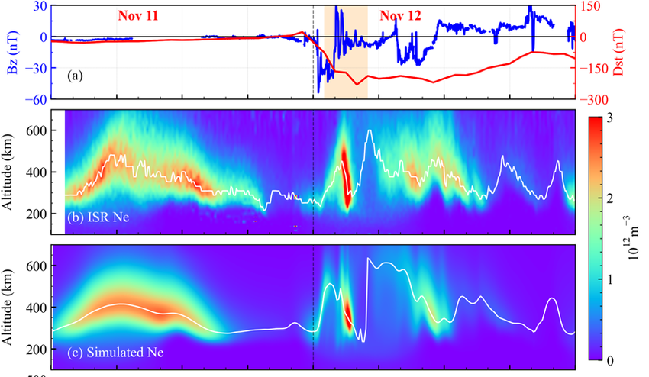
Space Weather Impacts
Short Wave Radio Blackouts
Dayside Ionospheric Density Enhancement
Jiang et al.
Communication and GPS failure
Satellites in LEO lost altitude

Slide 10
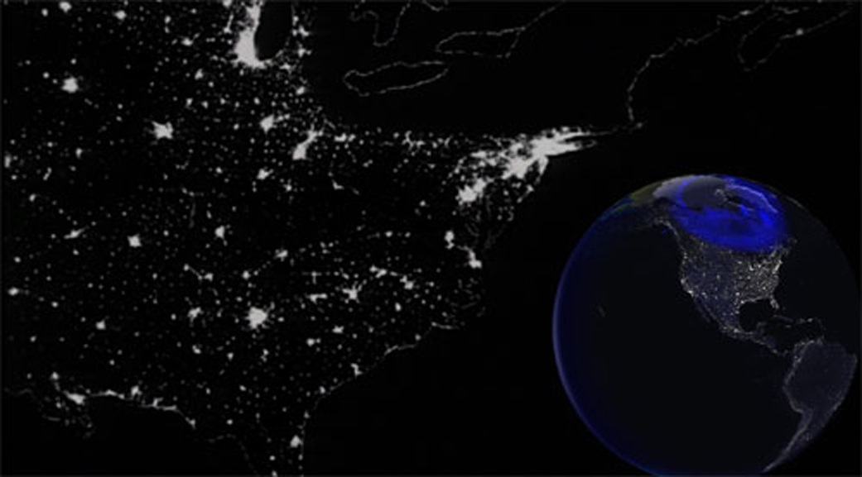
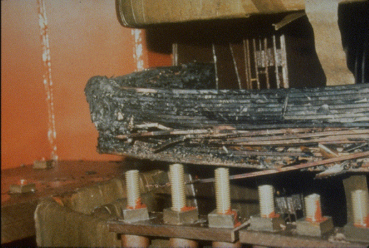
Space Weather Impacts
1989 Montreal Storm
Ground induced currents: Large change
in magnetic field can induce
currents on Earth’s surface
Can damage electrical infrastructure

Slide 11
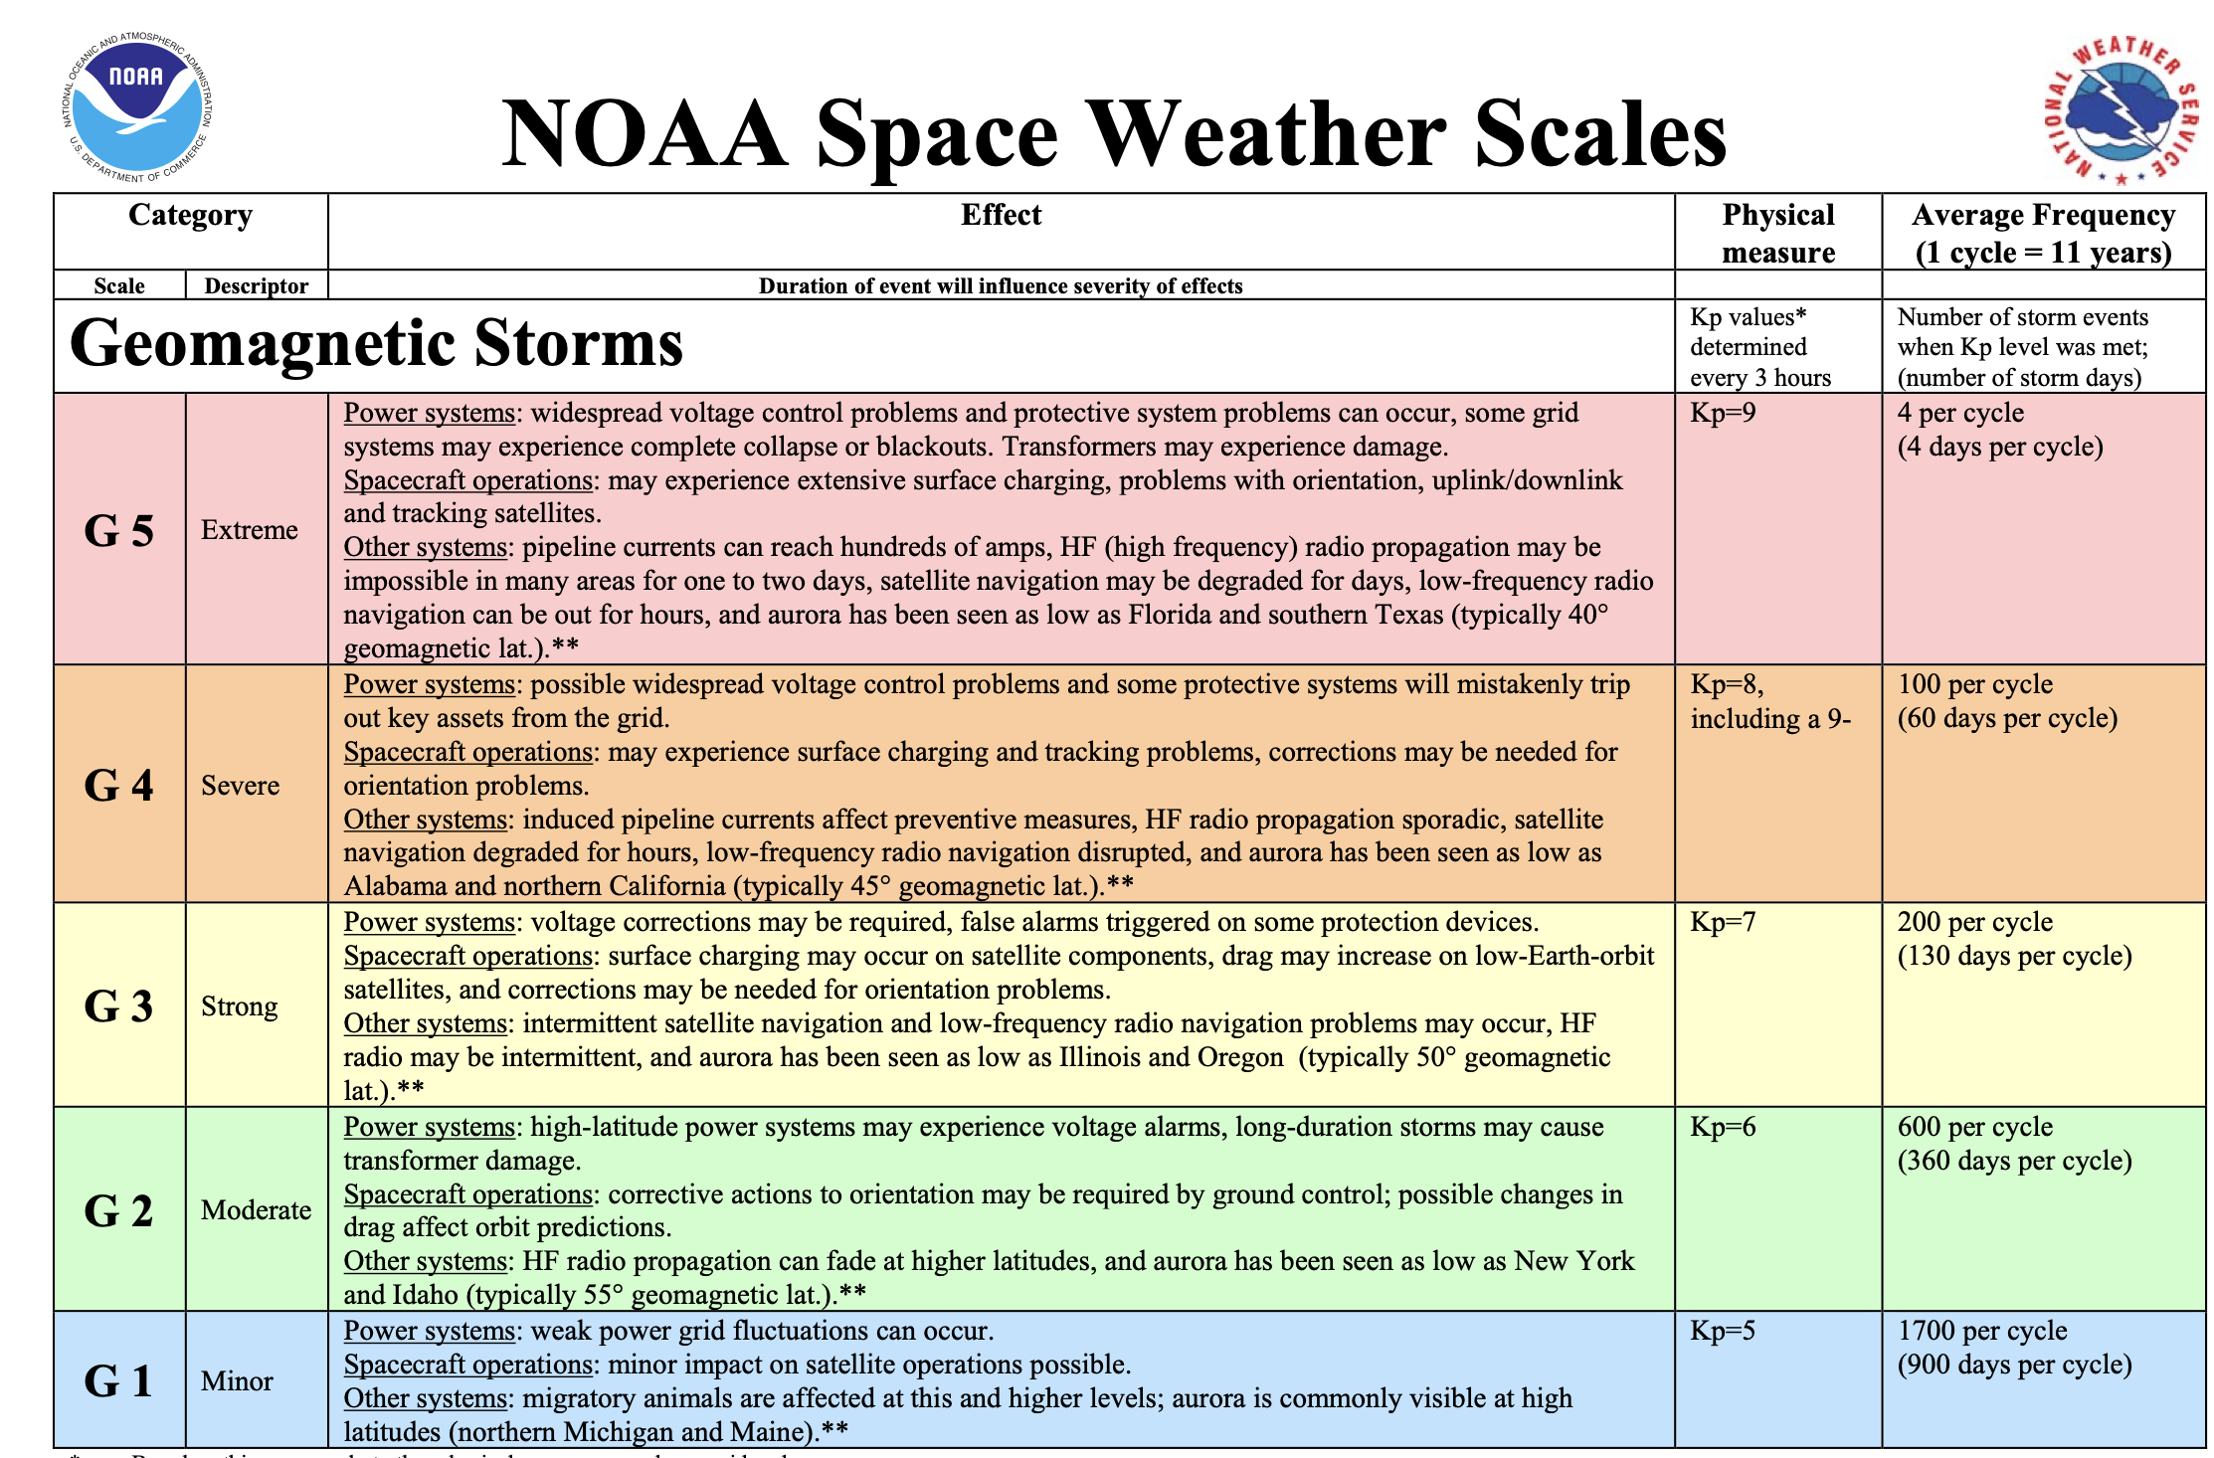
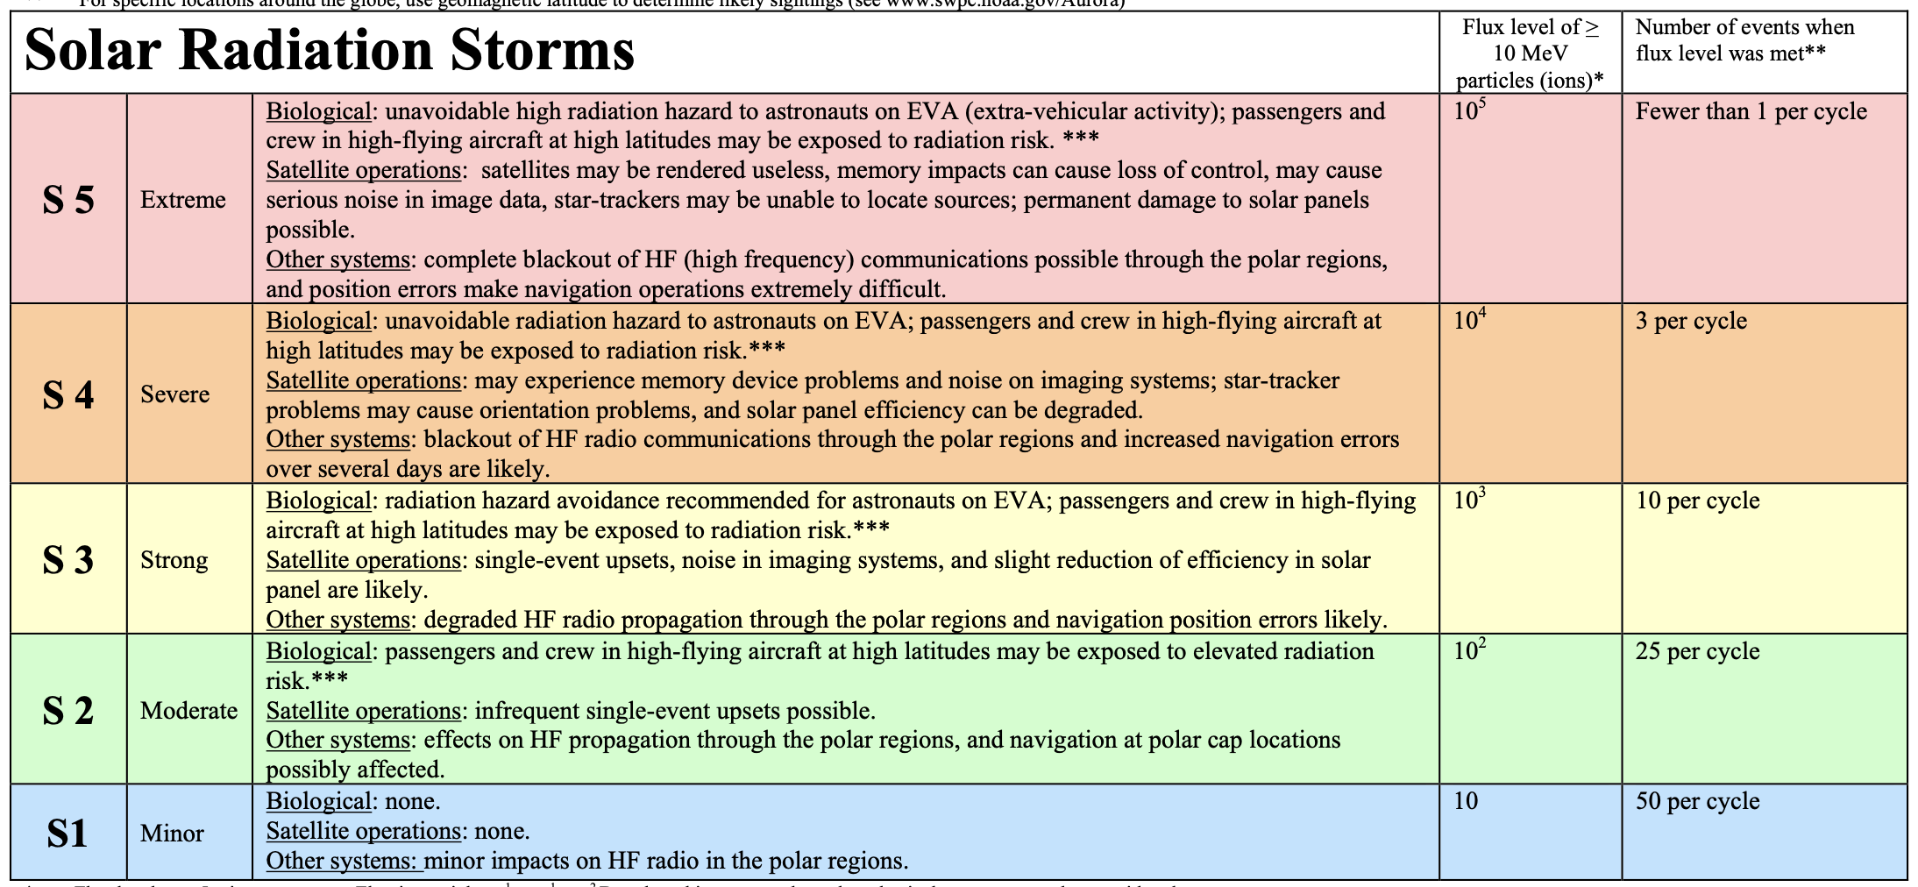
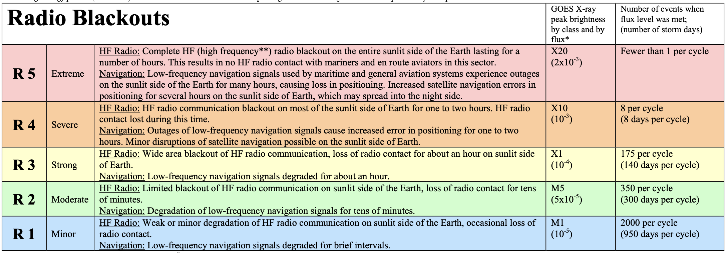
NOAA Space Weather Scales
Same idea as hurricane classification scale
Distinct scales to classify impact for each kind
Of geomagnetic storm

Slide 12
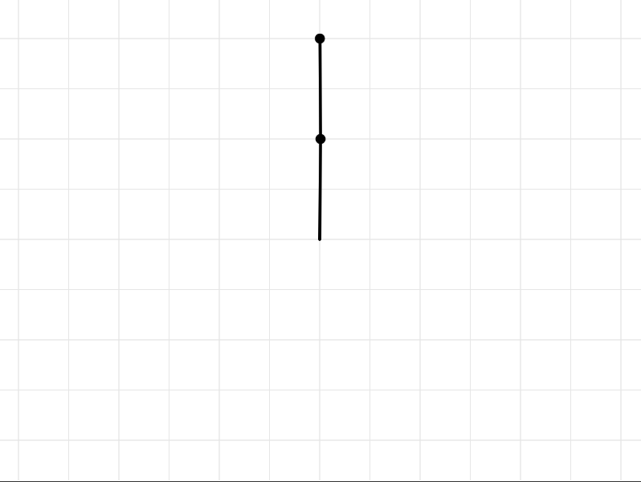
Chaotic vs. Strongly Driven Systems
Chaotic System

Slide 13
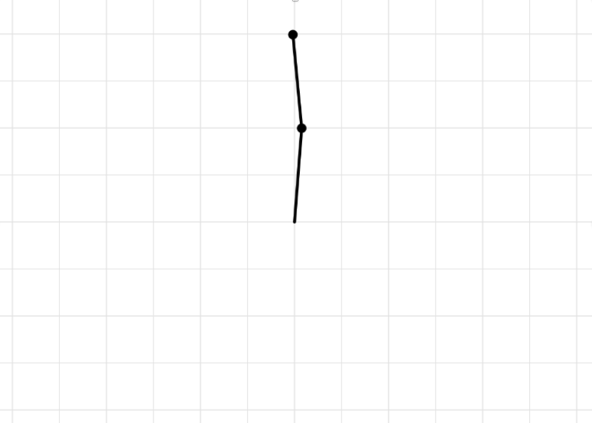
Chaotic vs. Strongly Driven Systems
Chaotic System
Strongly Driven System

Slide 14

Noisy Drivers Produce a Noisy System
Small scale turbulence in wind
drives ocean waves
Period and height of waves vary
Due to this noisy driver

Slide 15
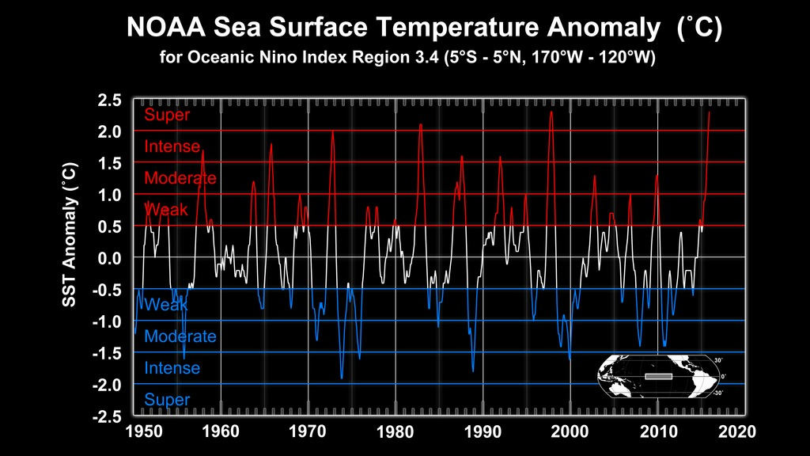
Terrestrial Weather vs. Space Weather Drivers
NOAA

Slide 16
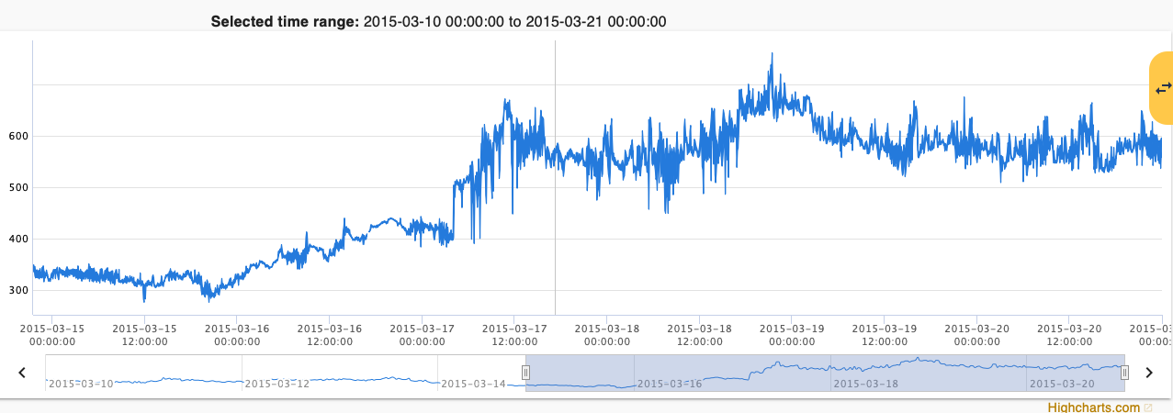
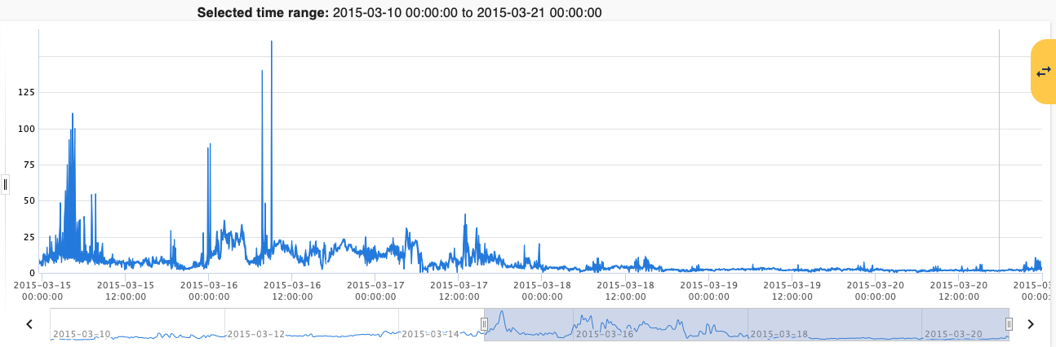
Terrestrial Weather vs. Space Weather
Solar Wind Bulk Speed
Solar Wind Proton Density
NOAA
Space Weather Data Portal

Slide 17

Drivers of Space Weather
Primary challenge of long-term (1-3 days) forecasting of space weather is forecasting drivers
Related to how much ground magnetometer readings change
During a given time window. Measure severity of Geomagnetic Storms
Geomagnetic Indices: Kp/Ap/Dst
Proxy for solar EUV emissions which is the primary driver of ionization
In the ionosphere
F10.7cm Solar Radio Flux
Solar Wind (Density, Speed, $B_{z}$)
Driver of geomagnetic storms

Slide 18

Drivers of Space Weather
Primary challenge of long-term (1-3 days) forecasting of space weather is forecasting drivers
Related to how much ground magnetometer readings change
During a given time window. Measure severity of Geomagnetic Storms
Geomagnetic Indices: Kp/Ap/Dst
Proxy for solar EUV emissions which is the primary driver of ionization
In the ionosphere
F10.7cm Solar Radio Flux
Solar Wind (Density, Speed, $B_{z}$)
Driver of geomagnetic storms

Slide 19
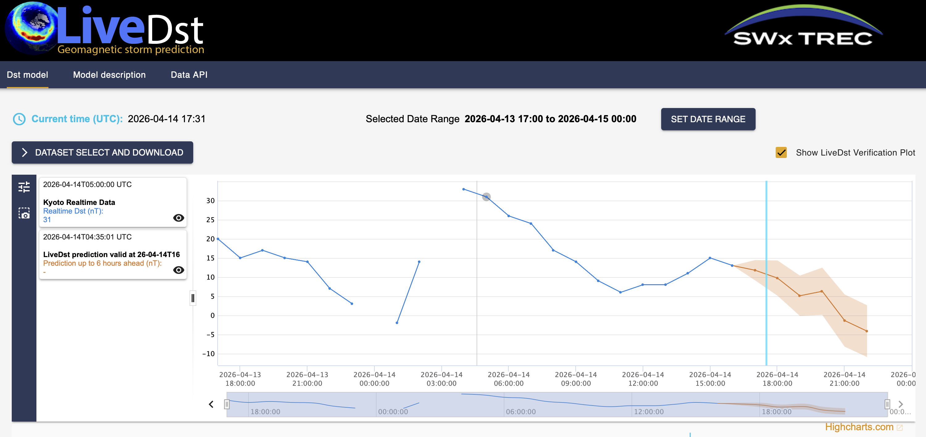
The Goal
LiveDST: Operational short term DST forecast
Develop improved operational-level
forecasts for drivers of space weather events
https://swx-trec.com/dst/
Developed by Andong Hu
Crucial to compare performance of newly developed
Models with current operational forecasts

Slide 20

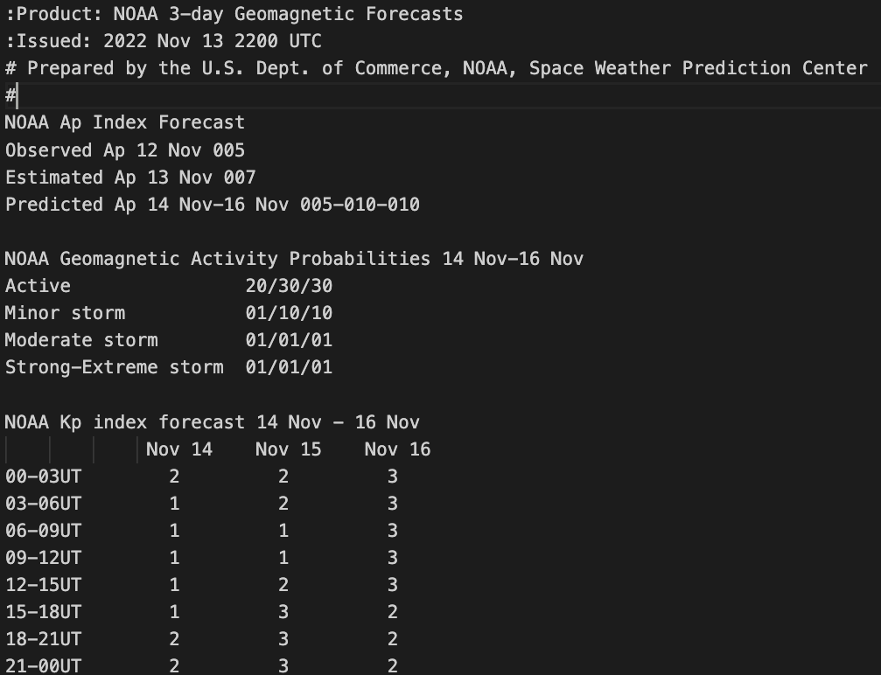
SWPC Forecast Products
Publish ~10 daily
forecast products
related to space weather
Archived reports hosted on NCEI website
NOAA 3-day Geomagnetic Forecast
3-day Kp forecast and 3-day Ap forecast

Slide 21
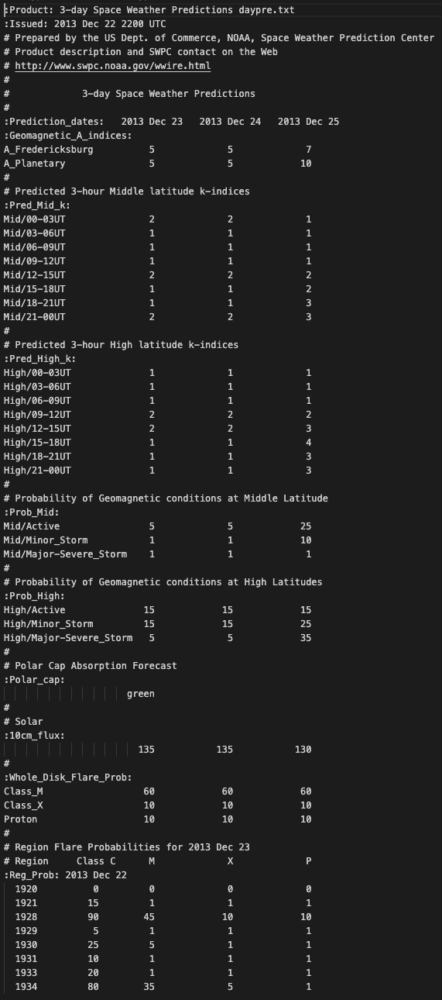
SWPC Forecast Products
Publish ~10 daily
forecast products
related to space weather
NOAA 3-day Space Weather Forecast (daypre)
3-day Ap Forecast
Archived reports hosted on NCEI website
NOAA 3-day Geomagnetic Forecast
3-day Kp forecast and 3-day Ap forecast

Slide 22
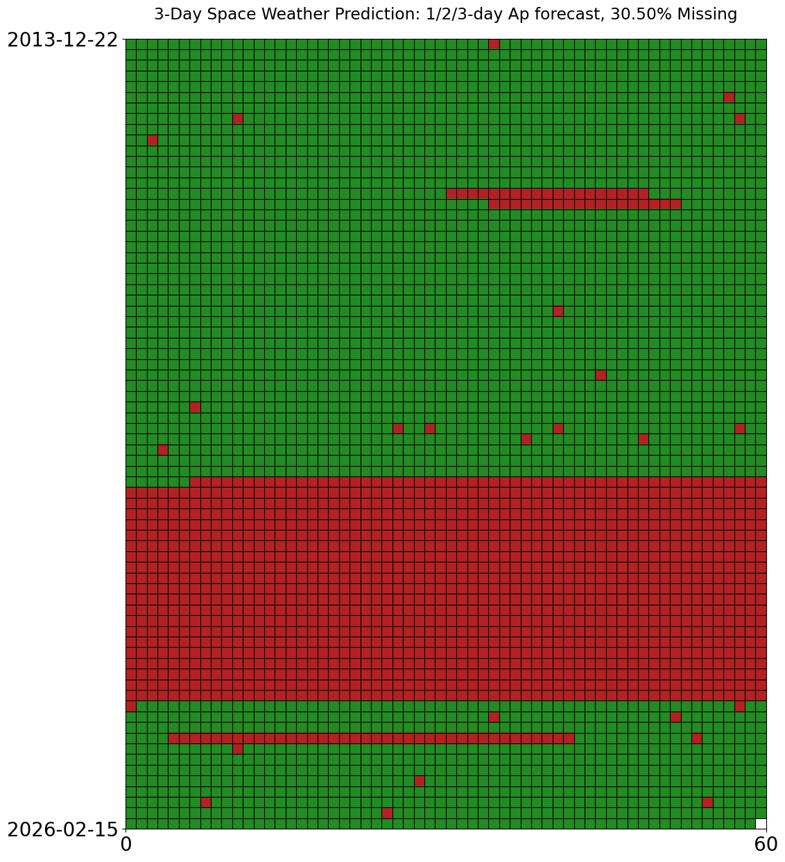
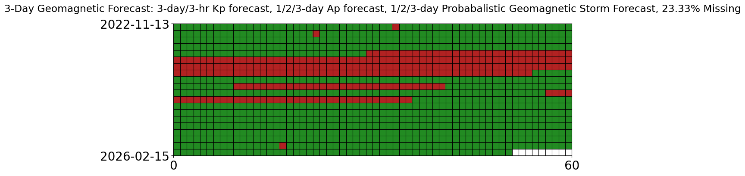
Forecast uptime
Density plot with custom colormap

Slide 23
Data Pipeline
Download Files
Extract Data
Process Data
Analysis

Slide 24
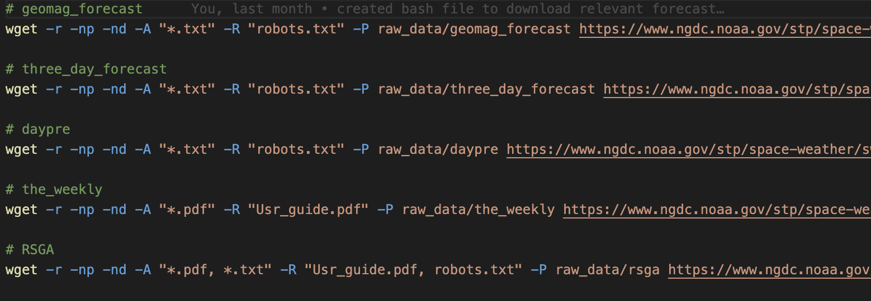
Data Pipeline
Unit testing
Download Files
Extract Data
Process Data
Analysis
Use bash script to download reports
Also download actual Kp/Ap values to compare to forecasted values

Slide 25
Data Pipeline
Download Files
Extract Data
Process Data
Analysis

Slide 26
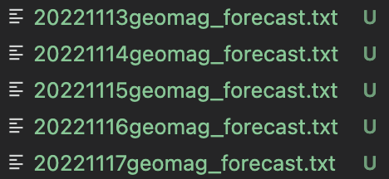
Data Pipeline
Download Files
Extract Data
Process Data
Analysis
1. Use file name to determine
Date of report

Slide 27
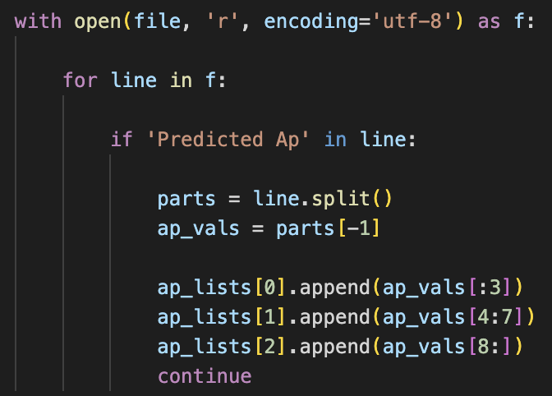
Data Pipeline
Download Files
Extract Data
Process Data
Analysis
1. Use file name to determine
Date of report
2. Use string manipulation
get data from file

Slide 28
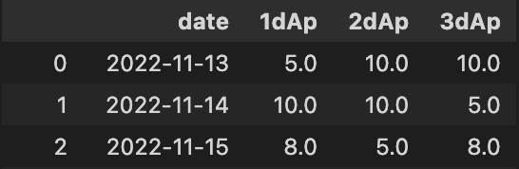
Data Pipeline
Download Files
Extract Data
Process Data
Analysis
1. Use file name to determine
Date of report
2. Use string manipulation
get data from file
3. Store data in DataFrame
And save as CSV

Slide 29
Data Pipeline
Download Files
Extract Data
Process Data
Analysis
DataFrame manipulations

Slide 30
Data Pipeline
Download Files
Extract Data
Process Data
Analysis

Slide 31
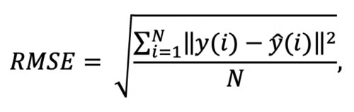
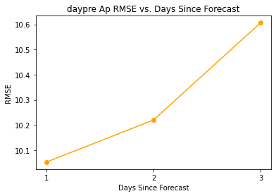
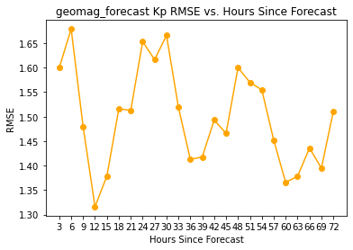
Results: RMSE

Slide 32
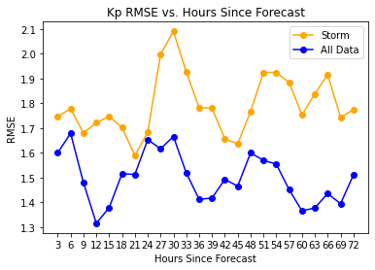
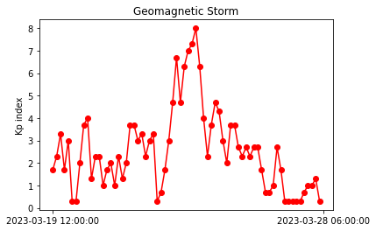
Results: RMSE During Geomagnetic Storms
Storm defined as Kp > 6 (G2)
12 events during report duration
Want to capture pre-storm phase, peak phase, and relaxation phase

Slide 33
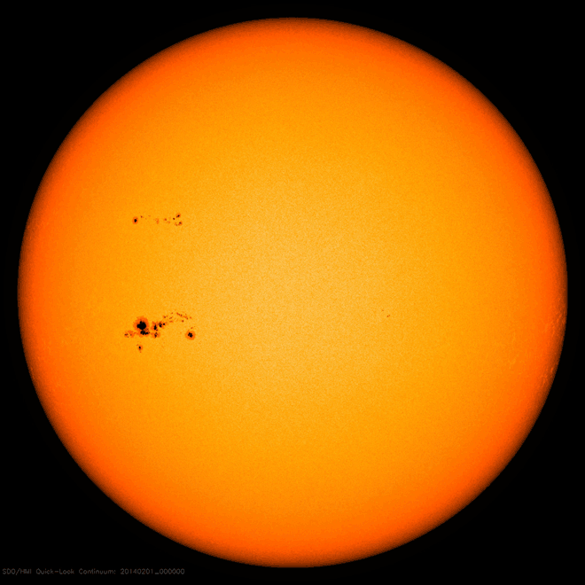
Next: Compared to Baseline Forecasts
Persistence: Conditions will remain identical to current conditions
Recurrence: Conditions will be identical to 27-days ago

